Slide 1
Endoscopic Ultrasonography in the Evaluation of Pancreatic Cysts by Sina Salimian MD

Slide 2
Introduction
Between 2% and 13% of patients undergoing CT or MRI, with no symptoms or history of pancreatic disease are found to have pancreatic cysts
Represent a broad spectrum from benign cysts to premaligant and malignant cysts
Despite advances in CT and MRI, the ability of cross-sectional modalities to identify the exact nature of a cyst remains limited
EUS is ideally suited for the imaging of pancreatic lesions because of its high resolution and ability to sample cystic lesions

Slide 3
Classification of Pancreatic Cysts
No or Very Low Malignant Potential
Malignant Potential
Malignant

Slide 4
No or Very Low Malignant Potential
Pseudocyst
Serous cystadenoma
Lymphoepithelial cyst
Retention cyst Pancreatoblastoma
Congenital cyst
Lymphangioma

Slide 5
Malignant Potential
Intraductal papillary mucinous neoplasm (IPMN)
Mucinous cystic neoplasm (MCN)

Slide 6
Malignant
Pancreatic ductal adenocarcinoma
Neuroendocrine tumor
Solid pseudopapillary neoplasm
Pancreatoblastoma
Acinar cell cystadenocarcinoma

Slide 7
Diagnostic Approach
Key questions
History of pancreatitis, jaundice, or recent onset of diabetes;
Any pancreatic type of abdominal or back pain, anorexia, or weight loss
Personal or family history of related cancers to suggest multiple endocrine neoplasia (MEN) 1, von Hippel–Lindau (VHL) syndrome
any history to suggest an increased risk of pancreatic adenocarcinoma, hereditary nonpolyposis colorectal cancer (HNPCC), Peutz-Jeghers syndrome, BRCA1 / BRCA2 mutation, or familial atypical multiple mole melanoma (FAMMM)

Slide 8
From MRI or CT and the clinical features, a diagnosis may be apparent.
It may also be clear that the patient requires surgical resection.
EUS is indicated when
the diagnosis is unclear or where the patient has worrisome symptoms

Slide 9
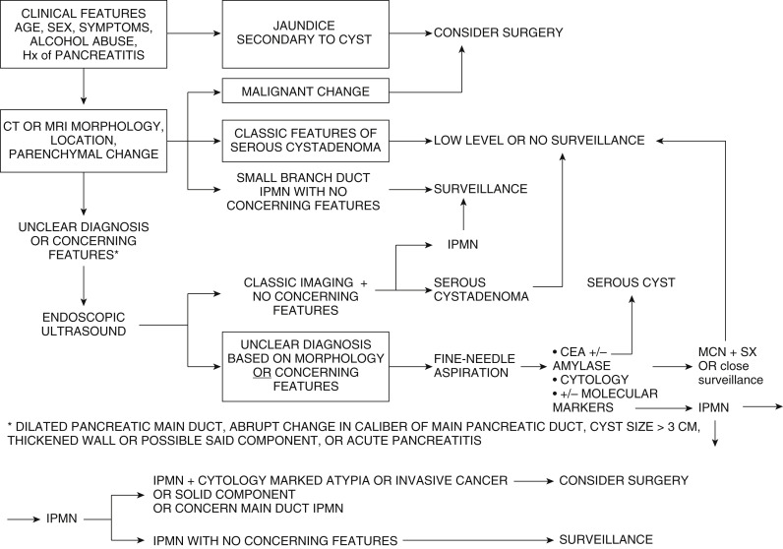

Slide 10
EUS FINDING

Slide 11
EXAMINATION CHECKLIST
Localize and describe cyst
Site and size
Wall thickness
Distance from lumen, interposed vessels
Focal irregularity, papillary projections, or mural nodules and the size of these lesion(s)
Associated mass lesion
Central or peripheral calcification
Presence and size of septation(s)
Debris or echogenic material in cyst
Communication and diameter of the pancreatic duct

Slide 12
EXAMINATION CHECKLIST
2. Examine the remaining pancreatic parenchyma looking in particular for a mass lesion not associated with the cyst.
3. Perform EUS-guided fine-needle aspiration (FNA) of all solid lesions
4. Perform EUS-guided FNA of cyst fluid under antibiotic cover.
5. Evacuate cyst contents if possible.
6. Send cyst fluid for carcinoembryonic antigen level and cytologic evaluation.

Slide 13
Several features on EUS that are worrisome for malignant transformation of the cyst
Presence of a thick wall or septum
An associated solid mass
Presence of focal dilation of the MPD
Pancreatic duct measuring ≥10 mm, or an MPD measuring between 5 and 9 mm with a mural nodule

Slide 14
Mural nodule versus a “mucin ball.”
Mucin typically has a round, hyperechoic, well-demarcated outer edge with a hypoechoic center.(on EUS it is associated with mucin in 90% of cases.)
Mucin can be shown to move within the cyst either by moving the patient’s position or by targeting the lesion during EUS FNA, which is then shown to move with the needle
CE EUS may demonstrate vascularity in mural nodules and is useful for differentiating a mural nodule from a mucin ball.

Slide 15
Endoscopic Ultrasound-Guided Fine-Needle Aspiration
There is no specific type or size of needle that should be used; the choice is determined by the size of the cyst, its location, and the presence of vessels around the cyst.
A single pass is made into the cyst to minimize the risk of complication and the fluid in that cyst locule is fully aspirated
Aspirating the cyst locule to dryness may decrease the risk of infection
Lesions that have a vascular component, such as cystic PanNETs, often yield bloody samples if large-bore needles are used; in such instances, a smaller-gauge needle (e.g., 22 or 25 gauge) may be helpful

Slide 16
Microcystic SCAs are particularly challenging to FNA
It is often difficult or impossible to obtain sufficient fluid for analysis from small cysts.
A 19-gauge needle can sometimes be used to obtain a core biopsy of the cyst.
One helpful technique is to target the wall of the cyst with a gentle to-and-fro motion to try to aspirate cells from the wall itself rather than simply aspirating fluid from the center of the cyst. This has been shown to increase the cytologic diagnostic yield for mucin-producing and malignant cysts. 22

Slide 17
A new through-the-needle microbiopsy forceps (Moray microforceps; US Endoscopy, Mentor, Ohio) has been developed that is placed within a 19-gauge EUS FNA needle
We await the results of these to determine the potential of this device, its adverse event profile, and its potential role in the evaluation of pancreatic cystic lesions

Slide 18
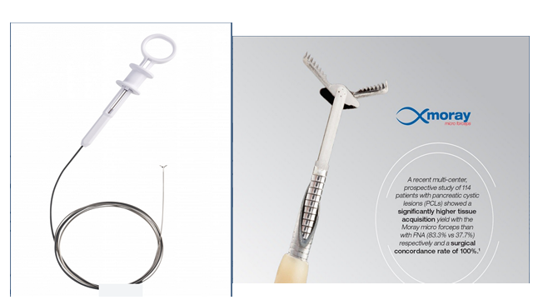

Slide 19
Endoscopic Ultrasound-Guided Fine-Needle Aspiration
The risk of adverse events from EUS FNA is slightly higher in pancreatic cystic lesions compared with FNA of a solid lesion
Antibiotic prophylaxis is recommended, usually with intravenous ciprofloxacin, before the procedure. The American Society of Gastrointestinal Endoscopy (ASGE) suggests that 3 to 5 days of oral ciprofloxacin may be continued
One concern about performing EUS FNA in pancreatic cystic lesions, which may harbor HGD or IC, is the potential risk of peritoneal seeding from FNA

Slide 20
Analysis of Cyst Fluid
Appearance of the Aspirate and the String Test
Fluid from pseudocysts can have a brown, bloody, or purulent exudate due to the presence of neutrophils
Lymphoepithelial cysts have a distinctive white, opaque fluid
Fluid from mucin-producing cysts is typically clear
Mucin-producing cysts typically produce viscous fluid, which may be difficult to aspirate
The “string test” is a simple clinical tool that relies on the viscosity of fluid to differentiate mucin producing from non–mucin producing cysts

Slide 21
string test
Following EUS FNA,a drop of fluid is placed between two gloved fingers, which are then slowly spread apart
A positive test is one in which a string of cyst fluid measuring 1 cm in length is formed and lasts for 1 second or more before disruption
One study that evaluated the string test found that it had performance characteristics similar to cyst fluid carcinoembryonic antigen (CEA),
The combination of the string test and cyst fluid CEA having improved performance characteristics as compared with each of these tests individually

Slide 22
Cytology
The specificity of cytology in most studies is excellent and approaches 100%, but the sensitivity varies considerably in reported series: 55% and 59%, 89% and 97%,
Sampling error may occur in both microcystic and mucinous lesions in which cellular atypia is patchy, which may lead to false-negative results
Presence of blood or benign epithelial cells from the gastric or duodenal mucosa can make interpretation difficult or lead to false positive results
The presence of on-site evaluation for adequacy of samples obtained by EUS FNA can improve results

Slide 23
Carcinoembryonic Antigen
CEA is found in high levels in mucin-producing cysts, whereas levels are low in pseudocysts and SCAs
The cutoff used by most endoscopists to differentiate a mucin-producing from a non–mucin producing cyst is greater than 192 ng/mL with an accuracy of 79%
Other studies have suggested an alternative cutoff that varies from 100 to 800 ng/ml
CEA concentration greater than 800 ng/mL strongly suggested a mucin-producing lesion (sensitivity, 48%; specificity, 98%). Conversely, a low level of CEA in cyst fluid of less than 5 ng/ml is strongly suggestive of a non–mucin producing PCL, such as a SCA (sensitivity, 50%; specificity, 95%).
Laboratories require anywhere from 0.25 to 1 mL of fluid

Slide 24
Carcinoembryonic Antigen
An elevated level of CEA in cyst fluid has not been shown to be associated with an increased risk of HGD or IC; therefore it should not be used as a marker of malignant transformation.
A very high or low cyst fluid CEA is helpful in either identifying or excluding a mucin-producing cyst

Slide 25
Cyst Fluid Amylase
Cyst fluid amylase requires approximately 0.5 mL of fluid for analysis
Should be sent if a pseudocyst is within the differential diagnosis.
A level of less than 250 U/mL virtually excludes a pseudocyst (sensitivity, 44%; specificity, 98%)
The levels of cyst fluid amylase vary in both MCN and IPMN and cannot be used to differentiate between these two entities

Slide 26
When to Perform EUS FNA and What to Send It for
We perform EUS FNA when the diagnosis is unclear and the result could alter management or concerning features

Slide 27
Analysis of Cyst Fluid
Appearance of the Aspirate and the String Test
Cytology: specificity 100%, sensitivities of 55% and 59%
Molecular Markers :
  KRAS and RNF43 : IPMNs and MCNs
  GNAS : almost exclusively in IPMNs
Protein Markers :
  CEA: cutoff greater than 192 ng/mL sensitivity of 63% and specificity of 93%
  Amylase : <250 U/mL excludes a pseudocyst, specificity 98%, sensitivity, 44%

Slide 28
Pseudocysts
Most common type of pancreatic cyst seen
Almost always occur in the setting of an episode of acute pancreatitis or in patients with chronic pancreatitis
Lack a true epithelial lining, as their walls consist of inflammatory and fibrous tissue. These walls are thin in early pseudocysts, but they may become thicker as they mature

Slide 29
Pseudocysts
Can be any size and are usually unilocular and anechoic
This appearance may change owing to the presence of necrotic debris or infection, thus mimicking a cystic neoplasm
Septations are rare but do occur
Often demonstrate direct communication with the MPD
Often helpful to look for features of acute or chronic pancreatitis elsewhere in the gland,
Should be noted are the distance between the intestinal wall and the cyst lumen and the presence of interposed (by Doppler examination) collateral vessels as evidence of segmental portal hypertension secondary to portal or splenic vein thrombosis. if endoscopic drainage of the pseudocyst is to be performed
Reactive, inflammatory looking lymph nodes may also be seen adjacent to the pseudocyst

Slide 30
FNA of Pseudocysts
Because pseudocysts lack an epithelial lining, no epithelial cells should be present in FNA samples unless there is contamination of the needle with gastric or duodenal epithelium during puncture.
Aspirated fluid is of low viscosity; it is often dark, turbid, or even bloody
Raised amylase (>5000 U/mL)
A low amylase level, of less than 250 U/mL, virtually excludes a pseudocyst
levels of other tumor markers should be low, although increased CEA levels have been reported when infection is present

Slide 31
Serous Cystadenoma
Commonly, although not exclusively, in women
Usually unifocal, or single
Can occur anywhere in the pancreas
Not communicate with the MPD
Carry an exceptionally small (0.1%) risk of transformation into cystadenocarcinomas
Microcystic (individual locules <1 cm) appearance is found in 45% to 58% of SCAs; 32% to 35% have a macrocystic (individual locules >1 cm) and 18% to 28% a mixed macrocystic or microcystic appearance
Central fibrosis or calcification is a classic appearance in SCA, but it occurs in fewer than 20% of cases.

Slide 32
Serous Cystadenoma
5% to 6% present as solid lesions due to the coalescence of multiple tiny (1- to 2-mm) cysts
Macrocystic SCAs can be difficult to differentiate from MCNs and branch duct IPMNs (BD-IPMN), whereas solid SCAs can Occasionally be mistaken for PanNET
Appearance of focal nodularity or thickening of the cyst wall, intracystic mucin, or floating debris is unusual and suggests that the lesion may be a mucin-producing tumor.

Slide 33
Serous Cystadenoma
Morphologic characteristics of SCAs are often diagnostic
Obtaining adequate amounts of cyst fluid for CEA analysis can be difficult due to the small size of the cysts
Cytologic examination may improve the diagnostic accuracy of EUS, particularly in the absence of the classic microcystic appearance
Cytologic appearance is of serous fluid containing small cuboidal cells that stain for glycogen but not mucin.
Fluid classically is clear and has a very low CEA concentration, with a level less than 5 ng/mL
Amylase levels are variable and can be high

Slide 34
Serous cystadenoma. Typical appearance of a 2.5-cm microcystic serous cystadenoma. It has multiple small (arrows) anechoic cystic areas and a “honeycomb” appearance. This lesion does not show the central area of fibrosis or calcification that is sometimes present

Slide 35
Macrocystic (oligocystic) serous cystadenoma. There is a
9-cm anechoic well-circumscribed cyst in the tail of the pancreas with thin septations. It was associated with low carcinoembryonic antigen and amylase levels; however, the patient was symptomatic and the cyst was therefore removed. Surgical pathology confirmed a serous cystadenoma

Slide 36
Serous Cystadenoma
Given their benign nature, SCAs should be resected only if they are clearly causing symptoms or where the diagnosis is unclear and imaging is concerning for the presence of HGD or IC.
Some groups have suggested that cases in which the diagnosis is certain do not require further follow-up, while others have recommended surveillance both approaches appear reasonable

Slide 37
Mucinous Cystic Neoplasm
Almost always single cysts
Most often in young or middle- aged women extremely rare in men
Found in the body or tail of the pancreas in over 90% of cases
Differentiated from IPMNs by the presence of ovarian stroma that contains both estrogen and progesterone receptors
Appear as macrocystic lesions
Peripheral calcification, which is found in 15% of patients, is highly suggestive of MCN but may also be seen in SPN
Classically do not communicate with the MPD

Slide 38
Mucinous Cystic Neoplasm
The presence of other cystic lesions elsewhere in the pancreas or a dilated pancreatic duct is unusual; if present, a diagnosis of IPMN should be considered

Slide 39
Mucinous cystadenoma. This 5-cm anechoic lesion was well circumscribed and contained a slightly thickened (4-mm) septation. Endoscopic ultrasound-guided fine-needle aspiration was performed, confirming a high level of carcinoembryonic fluid within the cyst. Cytology revealed mucin. A mucinous cystadenoma was confirmed on surgical pathology

Slide 40
Mucinous cystadenoma. The cyst wall is irregular and markedly thickened.

Slide 41
FNA of Mucinous Cystic Neoplasm
Useful in confirming the diagnosis
Fluid is usually clear
Cytology demonstrates viscous fluid containing mucin and columnar epithelial cells
Cyst fluid amylase levels vary and are not useful for differentiating MCNs from IPMNs

Slide 42
Mucinous Cystic Neoplasm
MCNs have a risk of malignant transformation. recent series reporting a risk of IC of between 4% and 13%
Surgical resection if:
causing symptoms, such as acute pancreatitis,
Imaging features concerning for malignant transformation
Cytology showing marked atypia or IC

Slide 43
Mucinous Cystic Neoplasm
Suggesting malignant transformation:
Presence of an irregular or thickened cyst wall
Solid region within the cyst
Adjacent solid mass
Strictured, obstructed, or displaced pancreatic duct

Slide 44
MCNs that measure less than 3 cm and have no concerning features
Some authors argue that all MCNs should be resected.This is based on the fact that:
(1) they occur in young women, who would otherwise require 30 to 40 years of surveillance
(2) they are single cysts, which, in contrast to IPMNs, do not recur
(3) they are located in the body or tail of the pancreas, which is technically easier to surgically resect than to perform a Whipple procedure
Distal pancreatectomy has a morbidity of about 25%, including a 15% to 20% risk of diabetes
Once a patient undergoes surgical resection for an MCN in the absence of IC, no further follow up is required.

Slide 45
Intraductal Papillary Mucinous Neoplasia
Almost 50% of surgically resected pancreatic cysts
Equally common in men and women
Can occur at any age but most frequently present in the sixth decade
Can occur throughout the pancreas but have a slight preponderance in the head of the pancreas
Up to 40% of cases, multiple cysts occur

Slide 46
Intraductal Papillary Mucinous Neoplasia
Presence of focal or diffuse dilation of the MPD and/or the presence of dilated side branches
classified as involving the MPD (MD-IPMN), the BD-IPMN, or both, in which case it is termed a mixed type of IPMN
MD-IPMN is defined as a focal or diffuse dilation of the MPD measuring more than 5 mm
Communication between side and main duct branches is a characteristic feature of BD-IPMN or mixed-IPMN
Filling defects can be seen in the MPD as well as in cysts and can result from either a mural nodule or mucous plugs

Slide 47
Differentiate mural nodule versus mucin ball
Mucin typically has a round, hyperechoic, well-demarcated outer edge with a hypoechoic center
Mucin move within the cyst either by moving the patient’s position or by targeting the lesion during EUS FNA, which is then shown to move with the needle
Large mural nodules or those associated with an ill-defined mass are highly concerning for the presence of HGD or IC
Contrast-enhanced EUS (CE EUS) may demonstrate vascularity in mural nodules and is useful for differentiating a mural nodule from a mucin ball

Slide 48
Main duct intraductal papillary mucinous neoplasia (MD-IPMN). The main pancreatic duct is markedly dilated, and hyperechoic nodules can be seen arising from the duct wall

Slide 49
Mural nodule arising from the pancreatic duct wall in a patient with a MD-IPMN.

Slide 50
Mucin. There is a lesion in the six o’clock position adjacent to the wall. It is well defined, with a hyperechoic wall and hypoechoic center. These features are suggestive of mucin

Slide 51
On endoscopic ultrasonography-guided fine-needle aspiration, the lesion was shown to move, confirming that it was mucin and not a mural nodule.

Slide 52
Intraductal Papillary Mucinous Neoplasia
In addition, patients with IPMNs are at increased risk of developing an IC, known as a concomitant pancreatic ductal adenocarcinoma
If concern for MD-IPMN, exclude other causes of main duct dilation such as chronic pancreatitis, a small pancreatic adenocarcinoma, or an ampullary mass.
The ampulla of Vater should be inspected, as a gaping “fish mouth” papilla extruding mucus is occasionally seen.
The presence of features such as a focal hypoechoic mass or mural nodules is suggestive of malignancy.
where the diagnosis remains unclear, EUS FNA of the MPD can be performed and samples sent for CEA, cytology looking for mucin, and molecular markers if required.

Slide 53
EUS FNA of Intraductal Papillary Mucinous Neoplasia
Fluid is usually clear
Elevated CEA
Cyst fluid amylase levels are not routinely performed as they are not helpful in differentiating an MCN from an IPMN
Cytology should be performed, however, as the presence of markedly atypical cytology is one of the criteria for considering surgical resection

Slide 54
Intraductal Papillary Mucinous Neoplasia
ICGs recommend surgery for patients with :
Jaundice
Enhancing solid component
Should undergo EUS, If
Recent history of pancreatitis
Nonenhancing mural nodule
MPD dilation measuring between 5 and 9 mm
where there was an abrupt change in the caliber of the MPD
Surgery is recommended if:
If there are features suspicious for malignancy : mural nodule, marked cytological atypia

Slide 55
Intraductal Papillary Mucinous Neoplasia
That size alone is a weak predictor of malignancy
Surgery should be considered in young, fit patients with BD-IPMN with cysts larger than 3 cm;
Surveillance can be considered in older patients with cysts larger than 3 cm without suspicious features.

Slide 56
Intraductal Papillary Mucinous Neoplasia
IPMNs can recur in the remnant pancreas following surgery
All patients who undergo surgical resection of an IPMN, even if no cysts are apparent within the remnant pancreas, require surveillance

Slide 57
Solid Pseudopapillary Neoplasm
Accounts for 5% of resected cystic pancreatic tumors
Usually occur in women, who make up 90% of cases
Can present over a wide age range but are typically found in patients in their mid-20s
Patients often have vague, nonspecific symptoms, with jaundice and pancreatitis being very rare presentations
Detected incidentally, with almost 40% of patients

Slide 58
Solid Pseudopapillary Neoplasm
Almost always single cysts
Can be found in the head, body, or tail of the pancreas
Usually well circumscribed.
Hallmark of this lesion is central hemorrhagic cystic degeneration, creating the classic solid, cystic appearance

Slide 59
Solid Pseudopapillary Neoplasm
EUS and EUS FNA and have found it helpful if other imaging is nondiagnostic:
Lesions are usually well demarcated and may appear solid or mixed solid and cystic with or without septations.
Peripheral calcification can occur and can also be seen in patients with MCNs
The hemorrhagic degeneration often results in a bloody, necrotic FNA sample that can provide a clue to the diagnosis, although the histologic features are usually characteristic.

Slide 60
Solid pseudopapillary neoplasm. This is the classic appearance of a solid pseudopapillary neoplasm. It is well defined, with both cystic and solid areas

Slide 61
Solid pseudopapillary neoplasm. Endoscopic ultrasound image of a pancreatic cyst lesion in the body of the gland revealing both solid and cystic components. Fine-needle aspiration proved this to be a solid cystic pseudopapillary neoplasm

Slide 62
Solid Pseudopapillary Neoplasm
Have clear malignant potential, with either lymph node involvement or distant metastases found in almost 8% of patient
Surgical resection is therefore recommended for all patients with SPNs
Patients who have undergone resection of a SPN should be followed for 5 years, as 5% will develop a recurrece.

Slide 63
Cystic Neuroendocrine Tumors
Most PanNETs are solid, but a small number can present with cystic degeneration
Can occur anywhere in the pancreas and are usually single
Usually well-defined lesions and do not communicate with the MPD.
Usually have a thickened wall or solid component
Remaining parenchyma and pancreatic duct are normal
EUS FNA is helpful in confirming a diagnosis, which can usually be made on cytology.
Neither cyst fluid CEA nor amylase is helpful in identifying these cysts

Slide 64
Pancreatic neuroendocrine tumor. This cyst has a thin septation; however, the wall is markedly thickened between the one and six o’clock positions. The solid component was targeted with endoscopic ultrasound-guided fine-needle aspiration and the diagnosis confirmed a pancreatic neuroendocrine tumor

Slide 65
Cystic Ductal Adenocarcinoma
Ductal adenocarcinoma of the pancreas may occasionally show cystic degeneration
They are ill-defined, and often have irregular, thickened walls with solid components
The diagnosis can be confirmed with EUS FNA, which should target the solid component

Slide 66
Cystic pancreatic ductal adenocarcinoma. (A) There is a cyst with a possible solid component between the 9 and 12 o’clock positions. (B) On further scanning, an irregular hypoechoic mass with an irregular edge becomes clear. Fine-needle aspiration (FNA) of the cyst fluid showed a low level of carcinoembryonic antigen and no mucin on cytology. FNA of the solid component confirmed an adenocarcinoma.

Slide 67
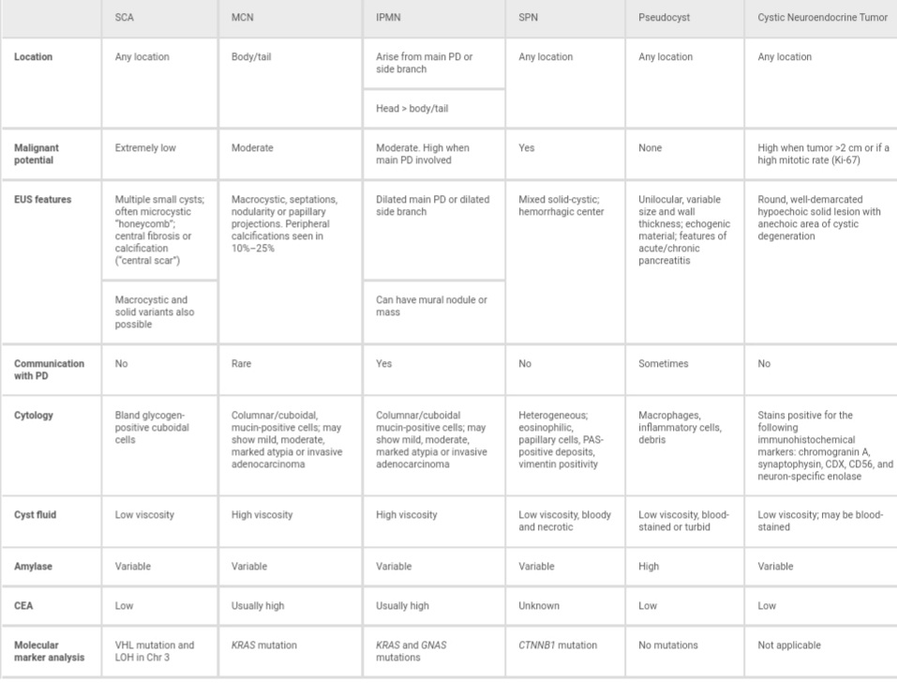

Slide 68
Thanks

